Slide 1
Continuous optimal transport
Brandon Amos • Meta AI (FAIR) NYC

Slide 2
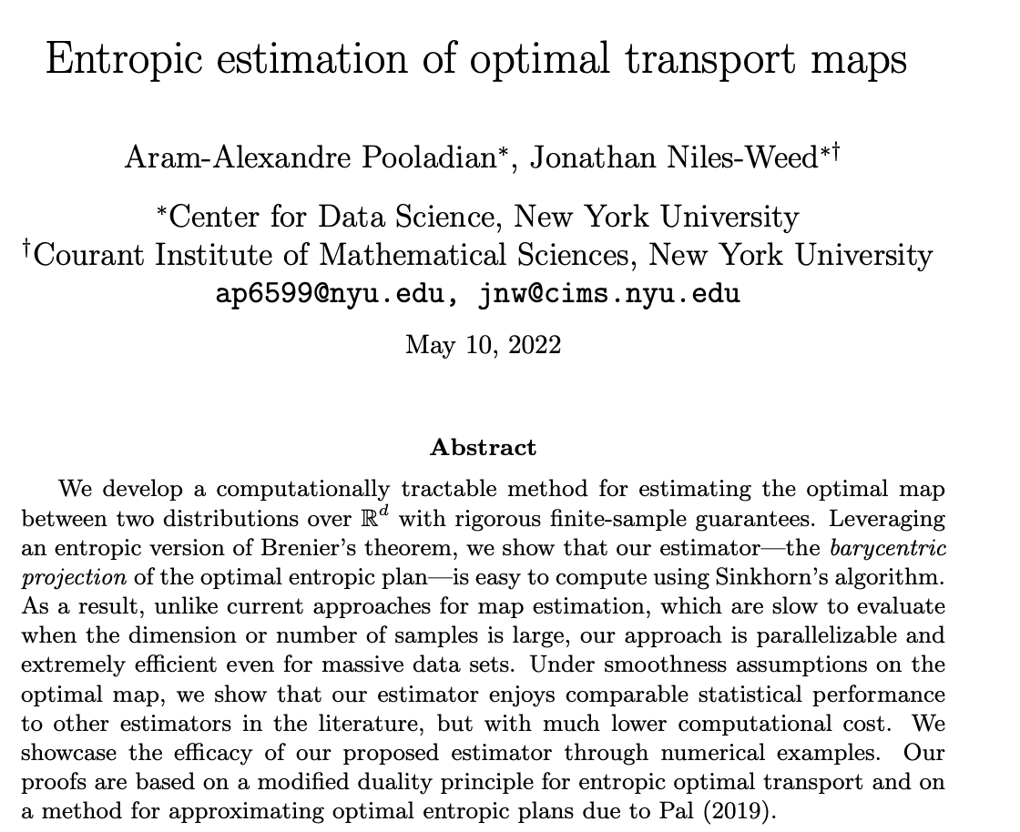

Slide 3
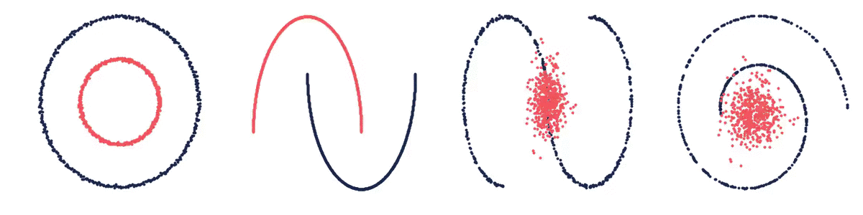
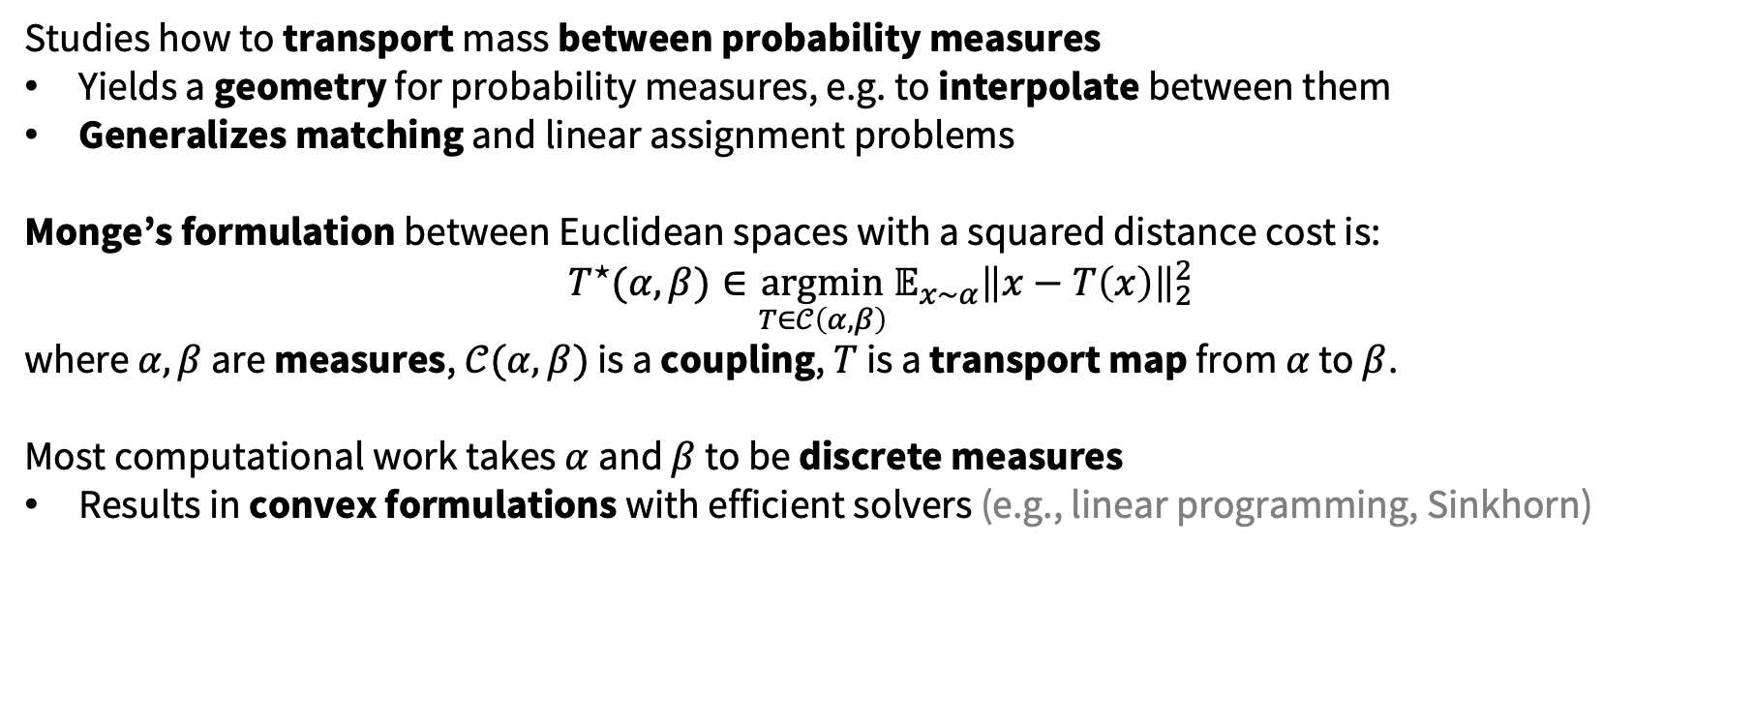
Background: optimal transport connects spaces
Studies how to transport mass between probability measures
Yields a geometry for probability measures, e.g. to interpolate between them
Generalizes matching and linear assignment problems
Monge’s formulation between Euclidean spaces with a squared distance cost is:
$${T^{⋆}(α, β)∈\underset{T∈𝒞\left(α, β\right)}{argmin}{𝔼_{x∼α}\left\|x−T\left(x\right)\right\|}}_{2}^{2}$$ where $α,β$ are measures, $𝒞(α, β)$ is a coupling, $T$ is a transport map from $α$ to $β$.
Most computational work takes $α$ and $β$ to be discrete measures
Results in convex formulations with efficient solvers (e.g., linear programming, Sinkhorn)

Slide 4
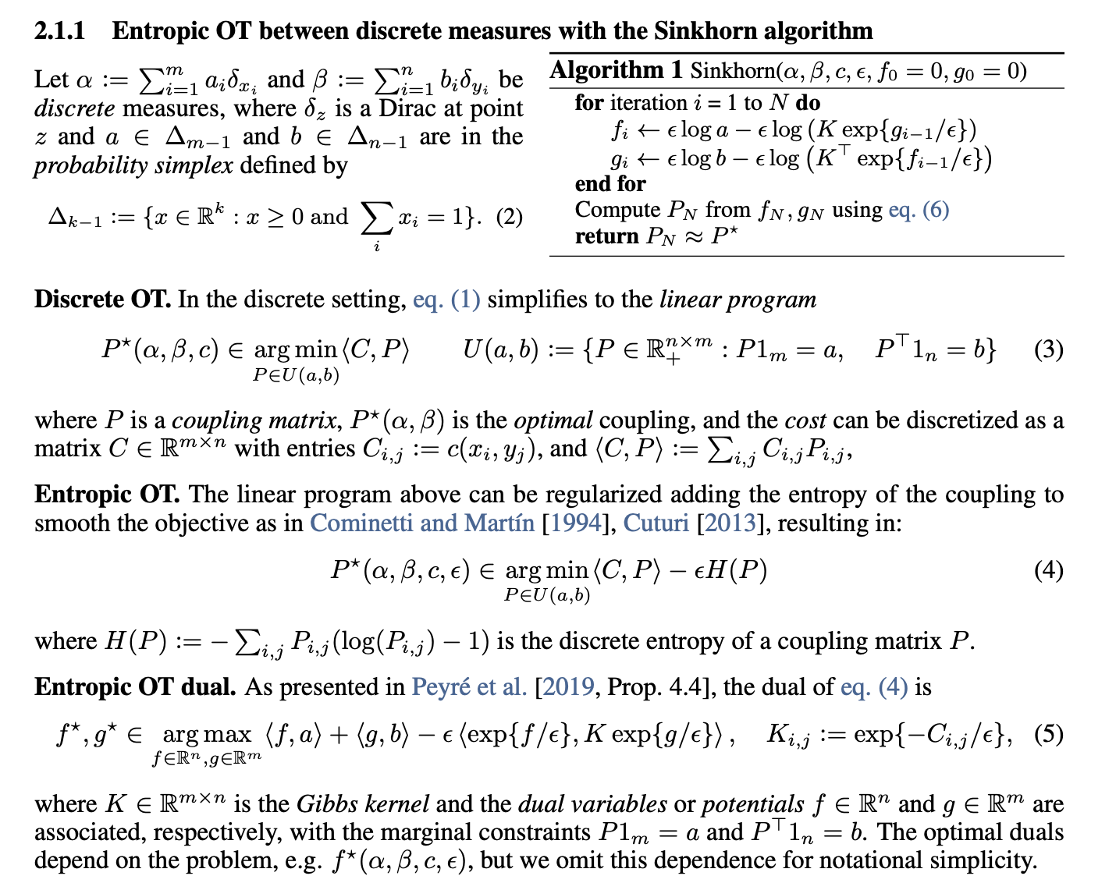

Slide 5
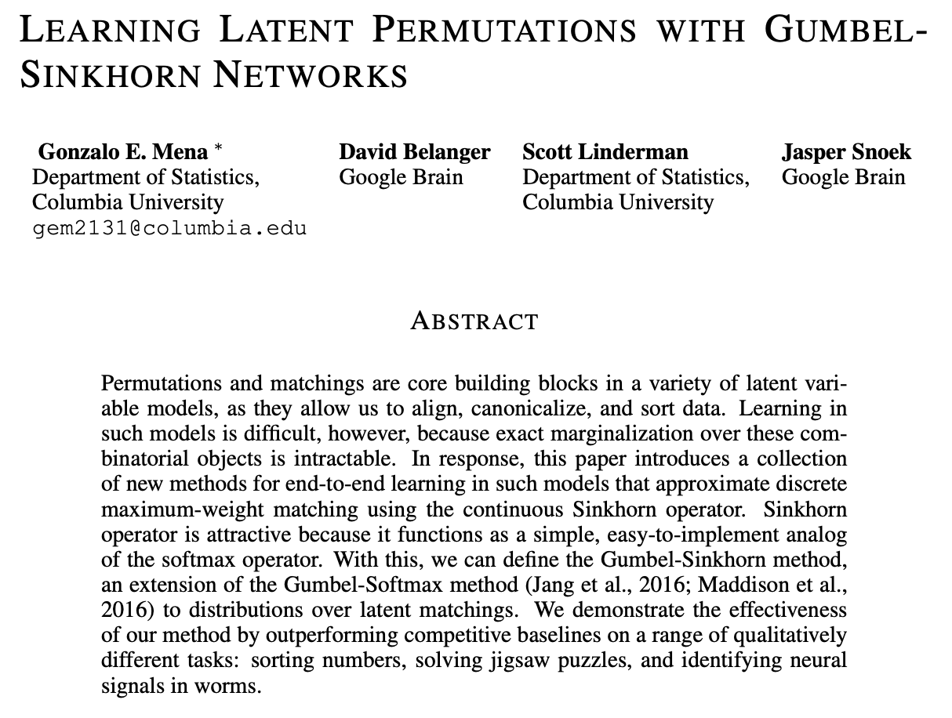
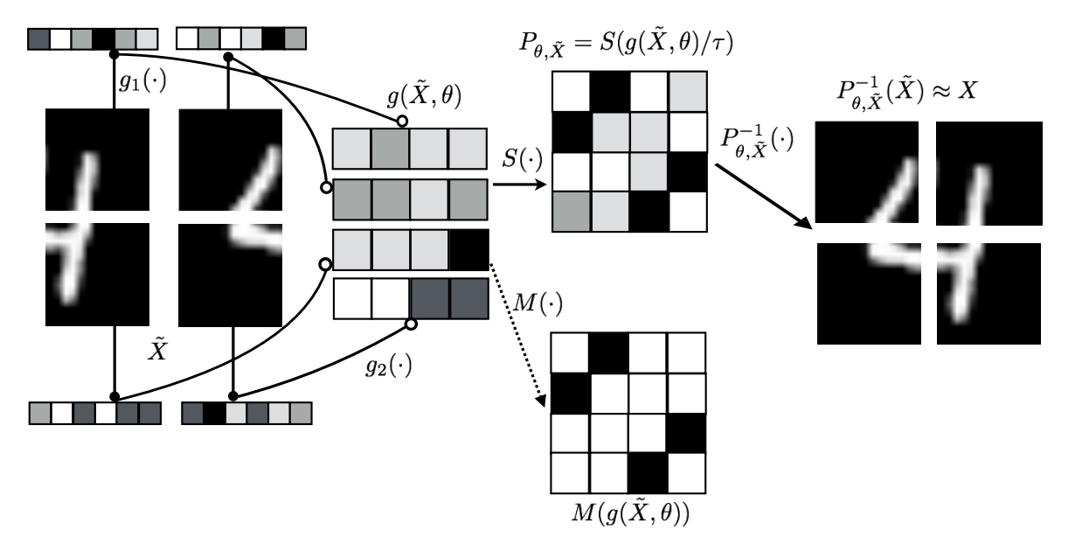
Discrete OT: permutations and matchings

Slide 6
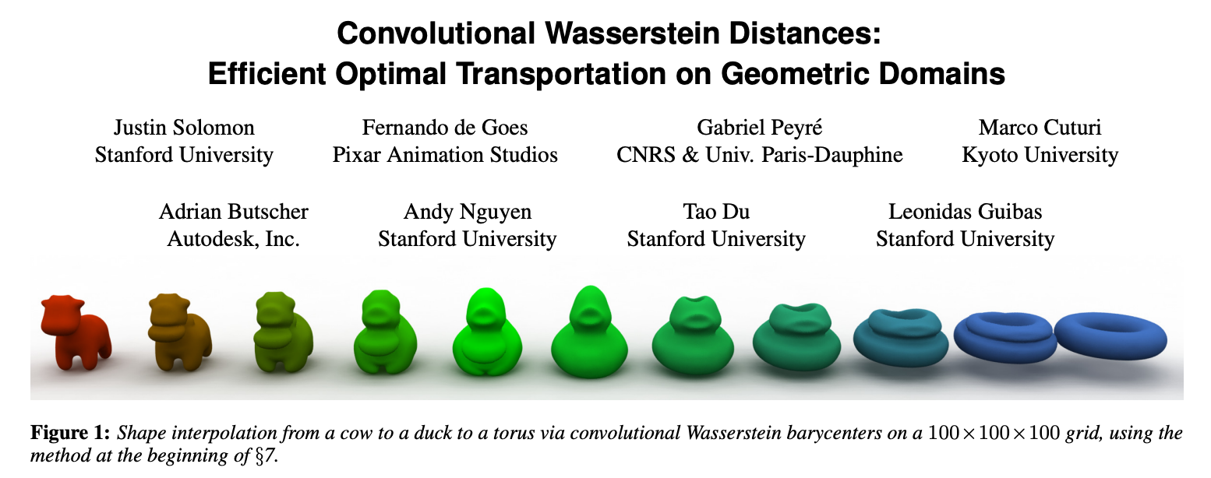

Slide 7
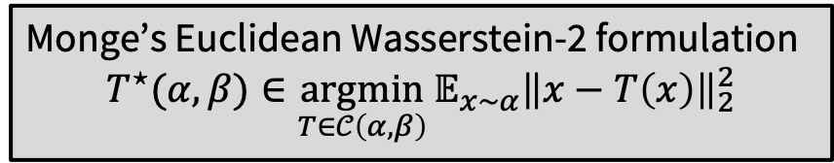
Limitations of discrete OT
Computationally challenging for high-dimensional measures (10k+ points)
Cost and coupling matrices may be large (100M+ entries when measures have 10k+ points)
Results in high-dimensional convex optimization problems
(Approximations may help reduce these burdens, e.g., hierarchies/slicing)
Uses discretized geometries that may come from truly continuous spaces
Ignores the continuous structure which may come up in practice
Not easy to obtain the true continuous transport map
Monge’s Euclidean Wasserstein-2 formulation
$${T^{⋆}(α, β)∈\underset{T∈𝒞\left(α, β\right)}{argmin}{𝔼_{x∼α}\left\|x−T\left(x\right)\right\|}}_{2}^{2}$$

Slide 8
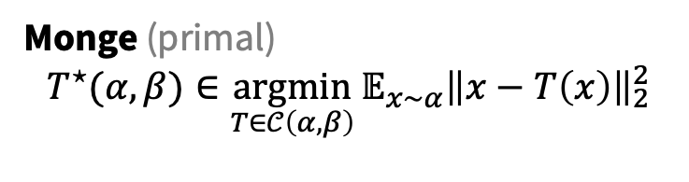
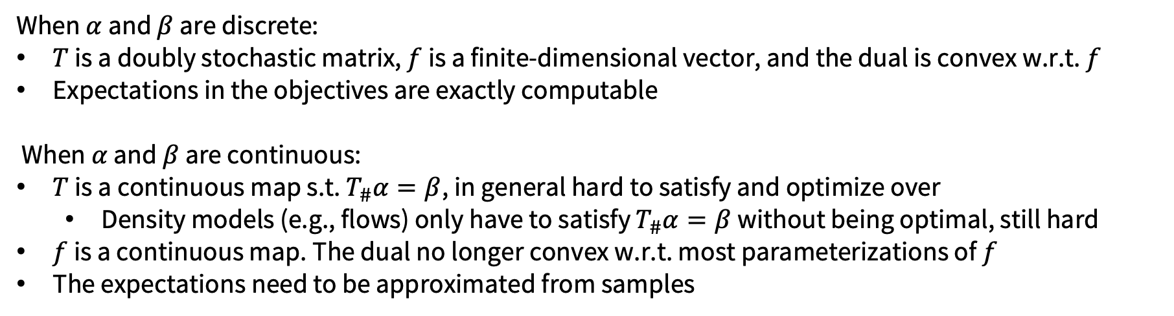
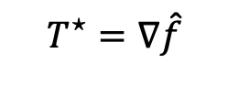
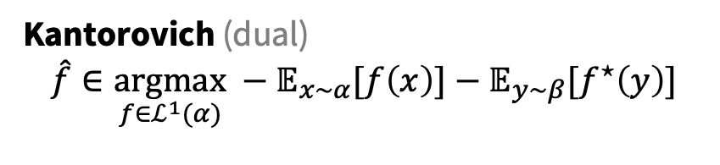
Duality and continuous OT
$$T^{⋆}=∇\hat{f}$$
Monge (primal)
$${T^{⋆}(α, β)∈\underset{T∈𝒞\left(α, β\right)}{argmin}{𝔼_{x∼α}\left\|x−T\left(x\right)\right\|}}_{2}^{2}$$
Kantorovich (dual)
$$\hat{f}∈\underset{f∈ℒ^{1}(α)}{argmax} −𝔼_{x∼α}[f\left(x\right)]−𝔼_{y∼β}[f^{⋆}\left(y\right)]$$
When $α$ and $β$ are discrete:
$T$ is a doubly stochastic matrix, $f$ is a finite-dimensional vector, and the dual is convex w.r.t. $f$
Expectations in the objectives are exactly computable
When $α$ and $β$ are continuous:
$T$ is a continuous map s.t. $T_{\#}α=β$, in general hard to satisfy and optimize over
Density models (e.g., flows) only have to satisfy $T_{\#}α=β$ without being optimal, still hard
$f$ is a continuous map. The dual no longer convex w.r.t. most parameterizations of $f$
The expectations need to be approximated from samples

Slide 9
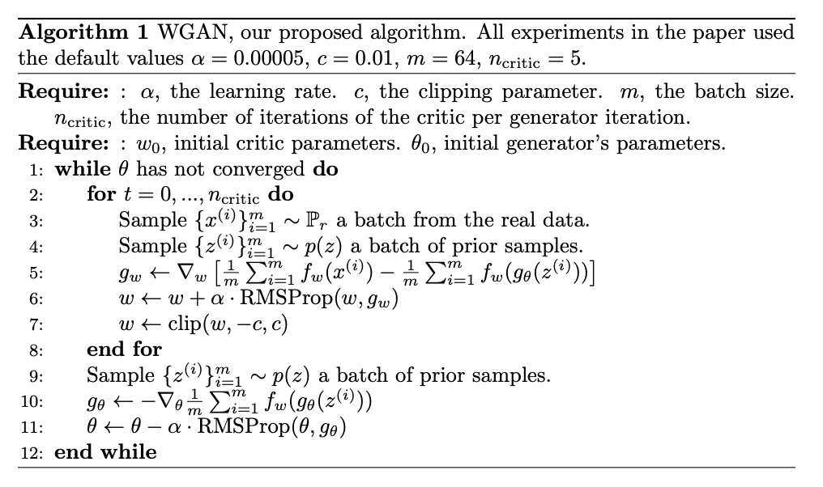
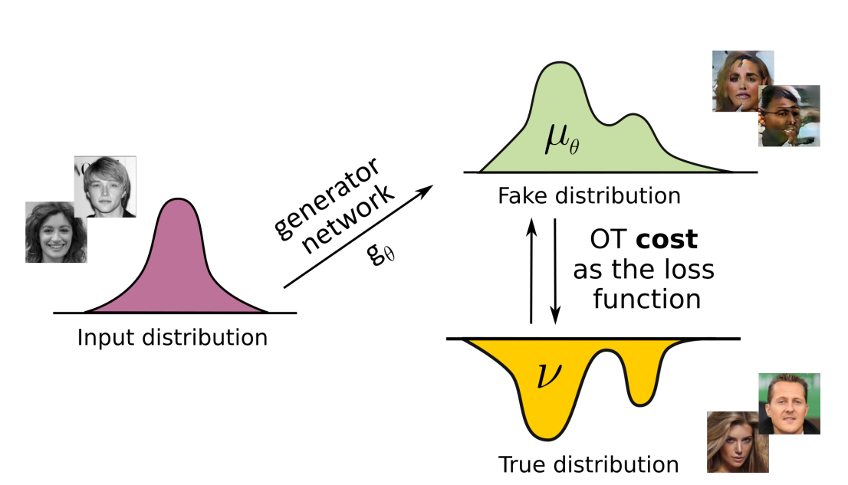
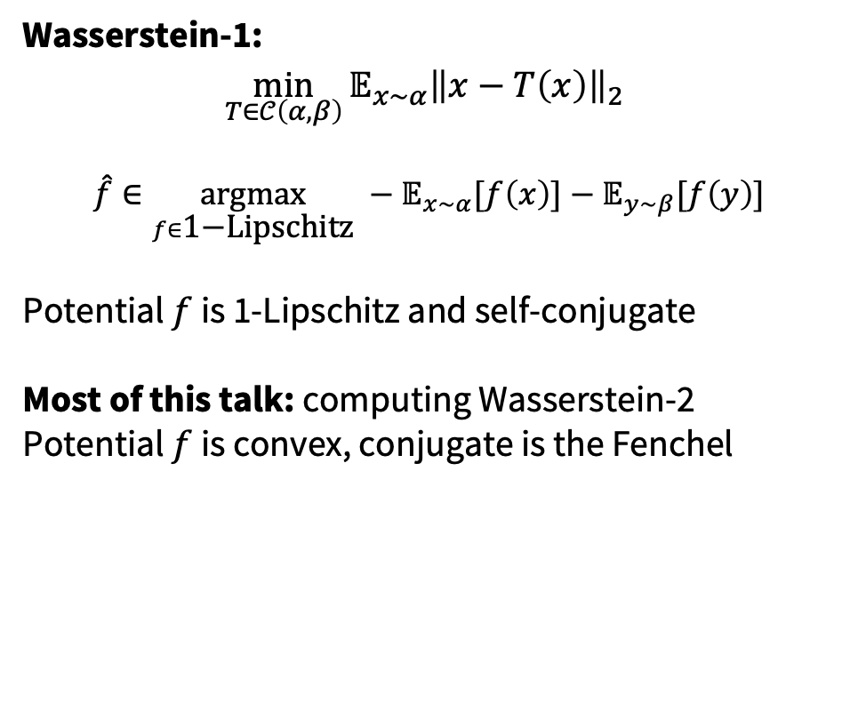
Wasserstein GAN: continuous Wasserstein-1 OT
Wasserstein-1:
$${\min_{T∈𝒞\left(α, β\right)}{𝔼_{x∼α}\left\|x−T\left(x\right)\right\|}}_{2}^{}$$
$$\hat{f}∈\underset{f∈\text{1−}\text{Lipschitz}}{argmax} −𝔼_{x∼α}[f\left(x\right)]−𝔼_{y∼β}[f\left(y\right)]$$
Potential $f$ is 1-Lipschitz and self-conjugate
Most of this talk: computing Wasserstein-2
Potential $f$ is convex, conjugate is the Fenchel
Source: Rout et al., ICLR 2022

Slide 10
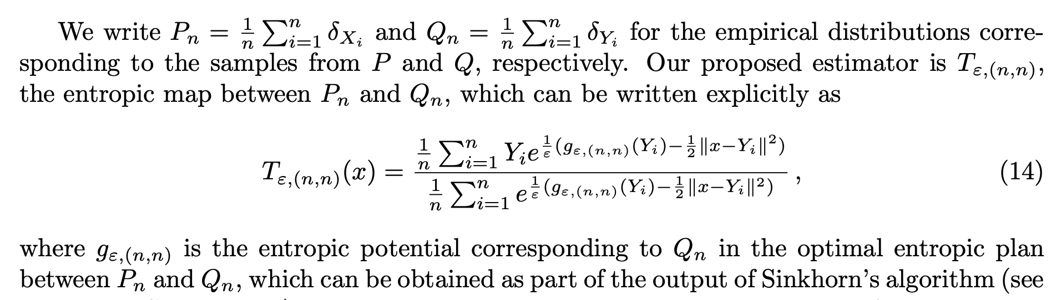
Computing continuous (Wasserstein-2) OT maps
Approach 1. solve a discrete OT problem with Sinkhorn and extend the solution to be continuous
Approach 2. use neural networks!
2-wasserstein approximation via restricted convex potentials. Taghvaei and Jalali, 2019.
Three-Player Wasserstein GAN via Amortised Duality. Nhan Dam et al., IJCAI 2019.
Optimal transport mapping via input convex neural networks. Makkuva et al., ICML 2020.
Wasserstein-2 generative networks. Korotin et al., ICLR 2020.
On amortizing convex conjugates for optimal transport. Amos, ICLR 2023.

Slide 11
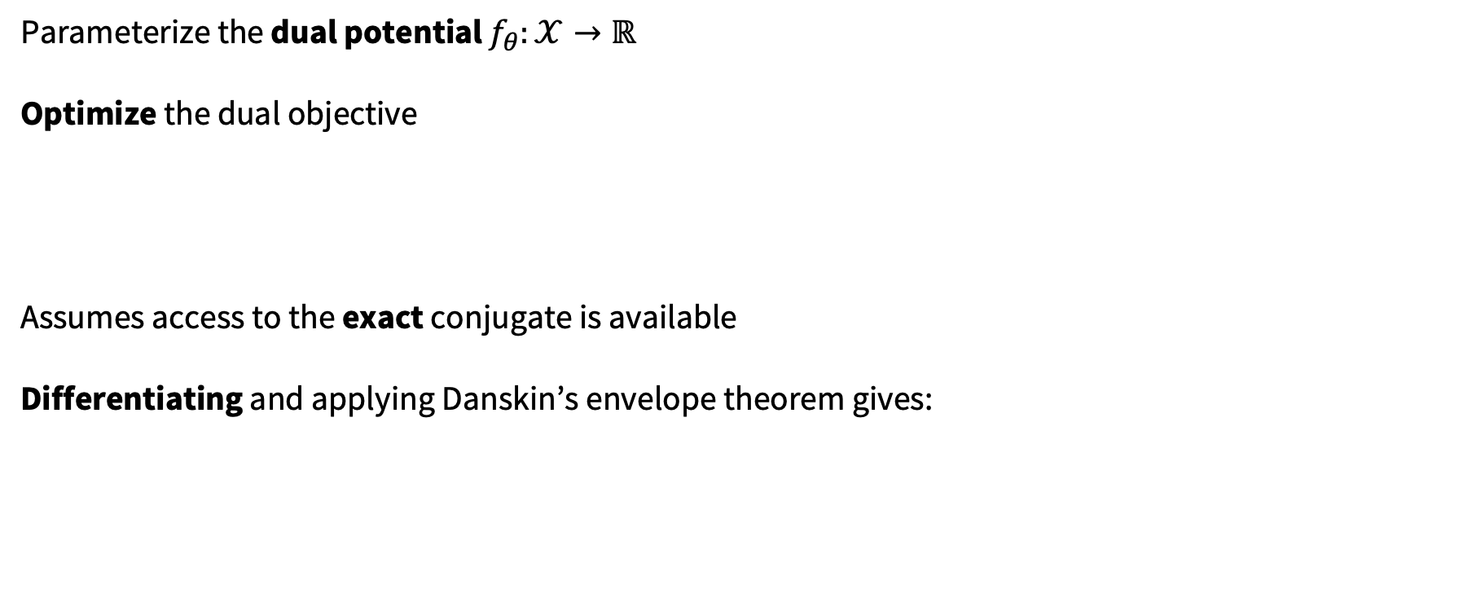
Solving Kantorovich’s dual with a neural net
2-wasserstein approximation via restricted convex potentials with application to improved training for GANs. Taghvaei and Jalali, 2019.
Parameterize the dual potential $f_{θ}:𝒳→ℝ$
Optimize the dual objective
Assumes access to the exact conjugate is available
Differentiating and applying Danskin’s envelope theorem gives:

Slide 12
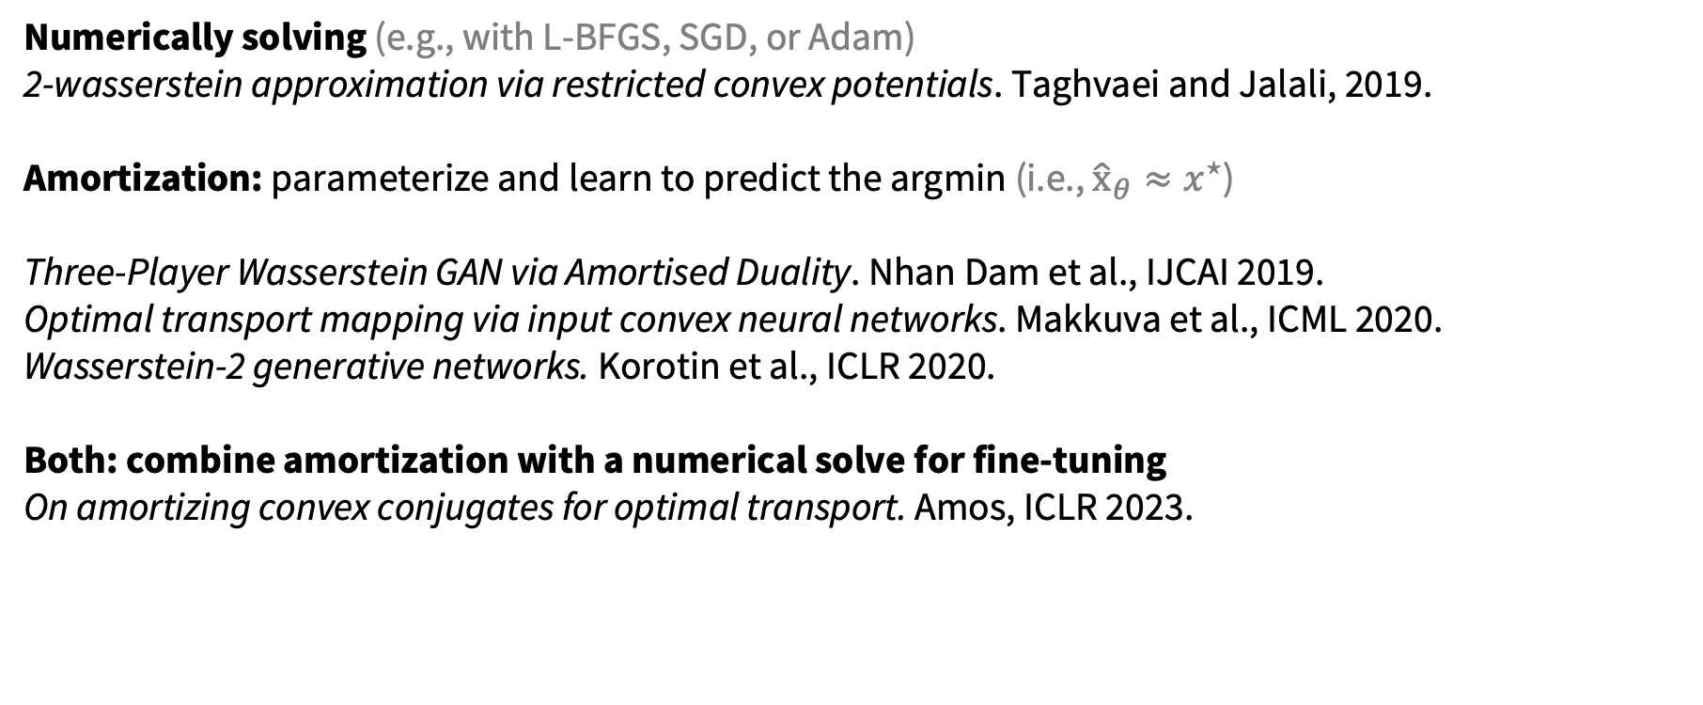

Computing the conjugate $f^{⋆}$
Numerically solving (e.g., with L-BFGS, SGD, or Adam)
2-wasserstein approximation via restricted convex potentials. Taghvaei and Jalali, 2019.
Amortization: parameterize and learn to predict the argmin (i.e., ${\hat{x}}_{θ}≈x^{⋆}$)
Three-Player Wasserstein GAN via Amortised Duality. Nhan Dam et al., IJCAI 2019.
Optimal transport mapping via input convex neural networks. Makkuva et al., ICML 2020.
Wasserstein-2 generative networks. Korotin et al., ICLR 2020.
Both: combine amortization with a numerical solve for fine-tuning
On amortizing convex conjugates for optimal transport. Amos, ICLR 2023.

Slide 13
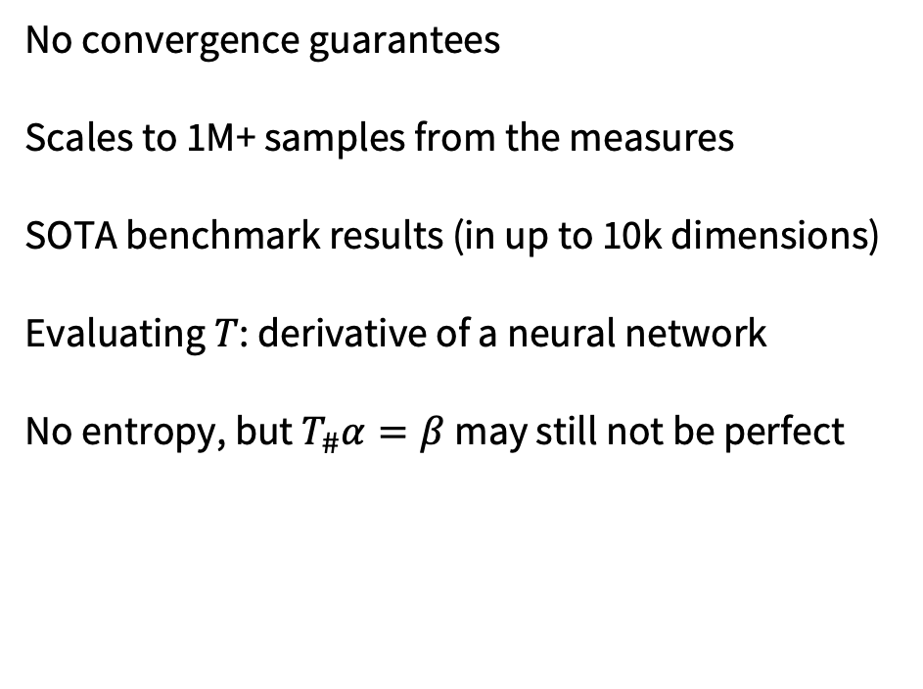
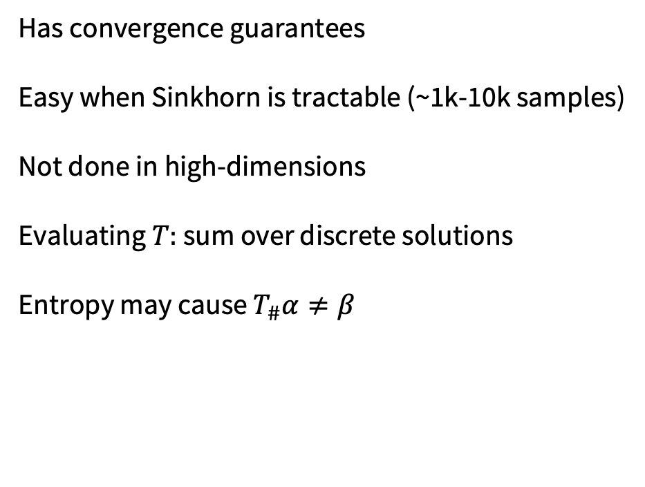
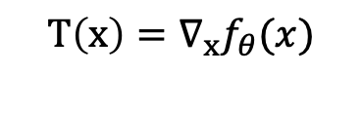
Entropic estimation vs. neural networks
$$T\left(x\right)=∇_{x}f_{θ}(x)$$
Has convergence guarantees
Easy when Sinkhorn is tractable (~1k-10k samples)
Not done in high-dimensions
Evaluating $T:$ sum over discrete solutions
Entropy may cause $T_{\#}α≠β$
No convergence guarantees
Scales to 1M+ samples from the measures
SOTA benchmark results (in up to 10k dimensions)
Evaluating $T$: derivative of a neural network
No entropy, but $T_{\#}α=β$ may still not be perfect

Slide 14
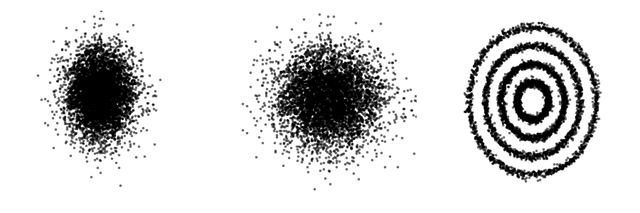
Learning flows via continuous OT
On amortizing convex conjugates for optimal transport. Amos, ICLR 2023.
Challenges for learning flows (with potentials or otherwise)
1. The model needs to be invertible
2. The likelihood of the base density is required
Optimizing the potential-based flow for the Kantorovich dual can help with both of these!
1. Often parameterize the model as a non-convex MLP, invertibility no longer matters
2. Only requires samples from the densities

Slide 15
Beyond Euclidean Wasserstein-2 OT
Unpublished/active areas of research I’m thinking about:
Continuous Riemannian OT
Continuous Gromov-Wasserstein

Slide 16
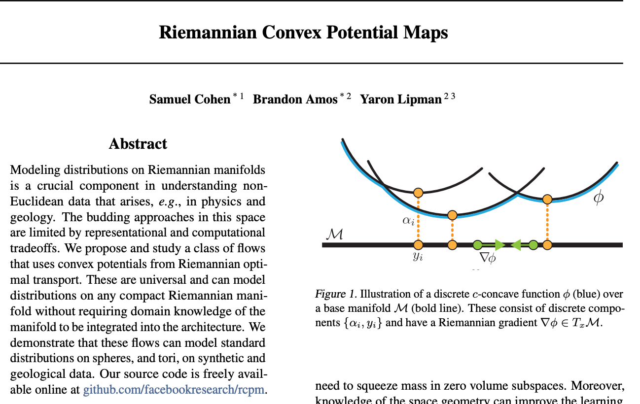
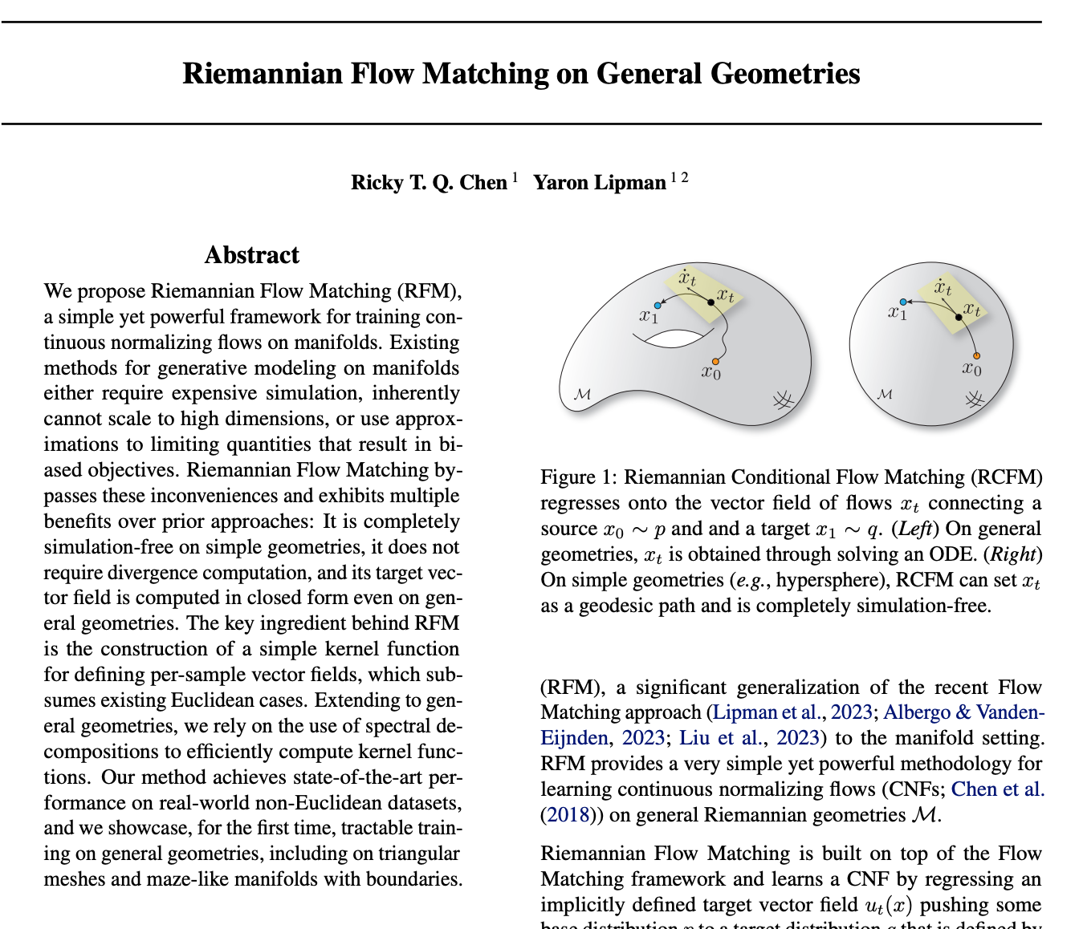
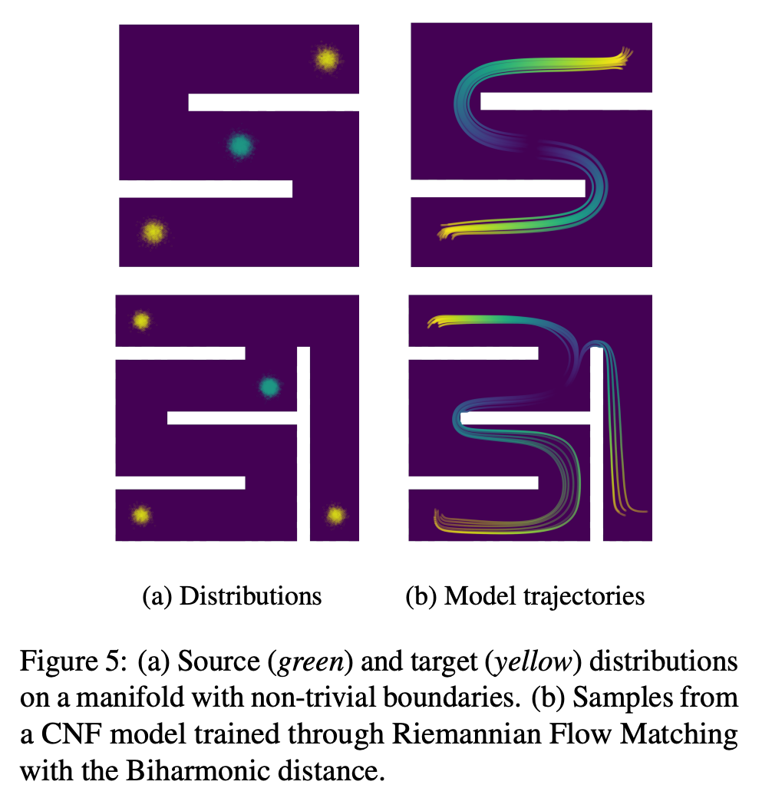
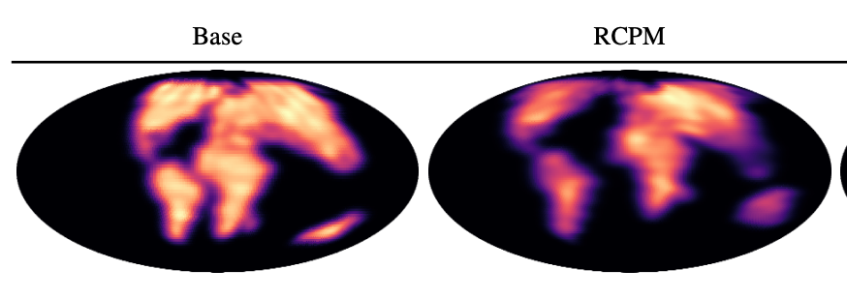
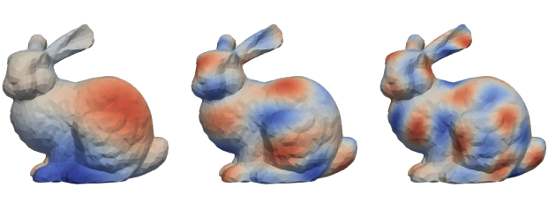
Continuous Riemannian OT
Existing work getting close, but not computing OT

Slide 17
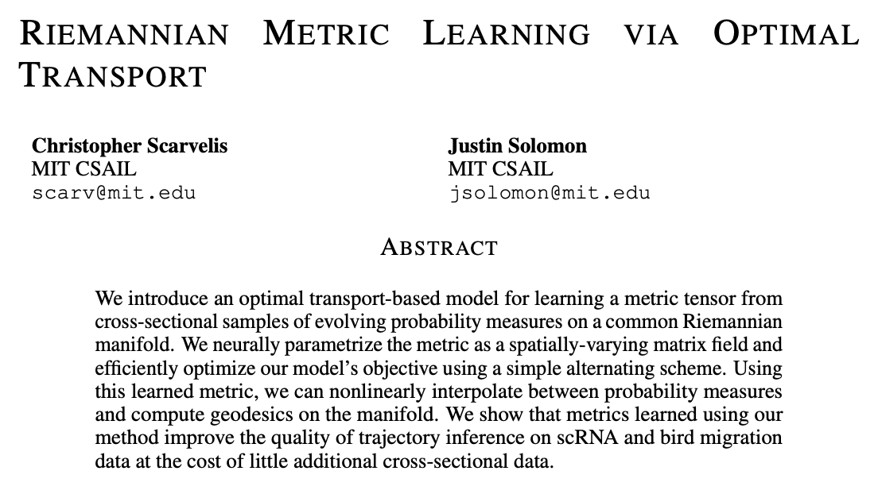
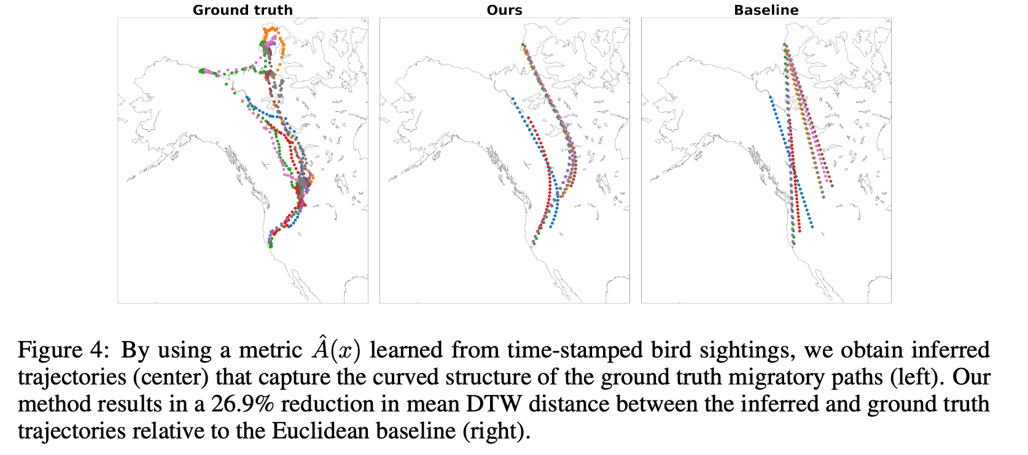
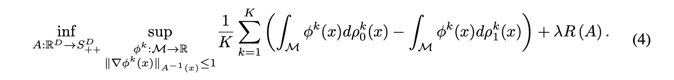

Slide 18
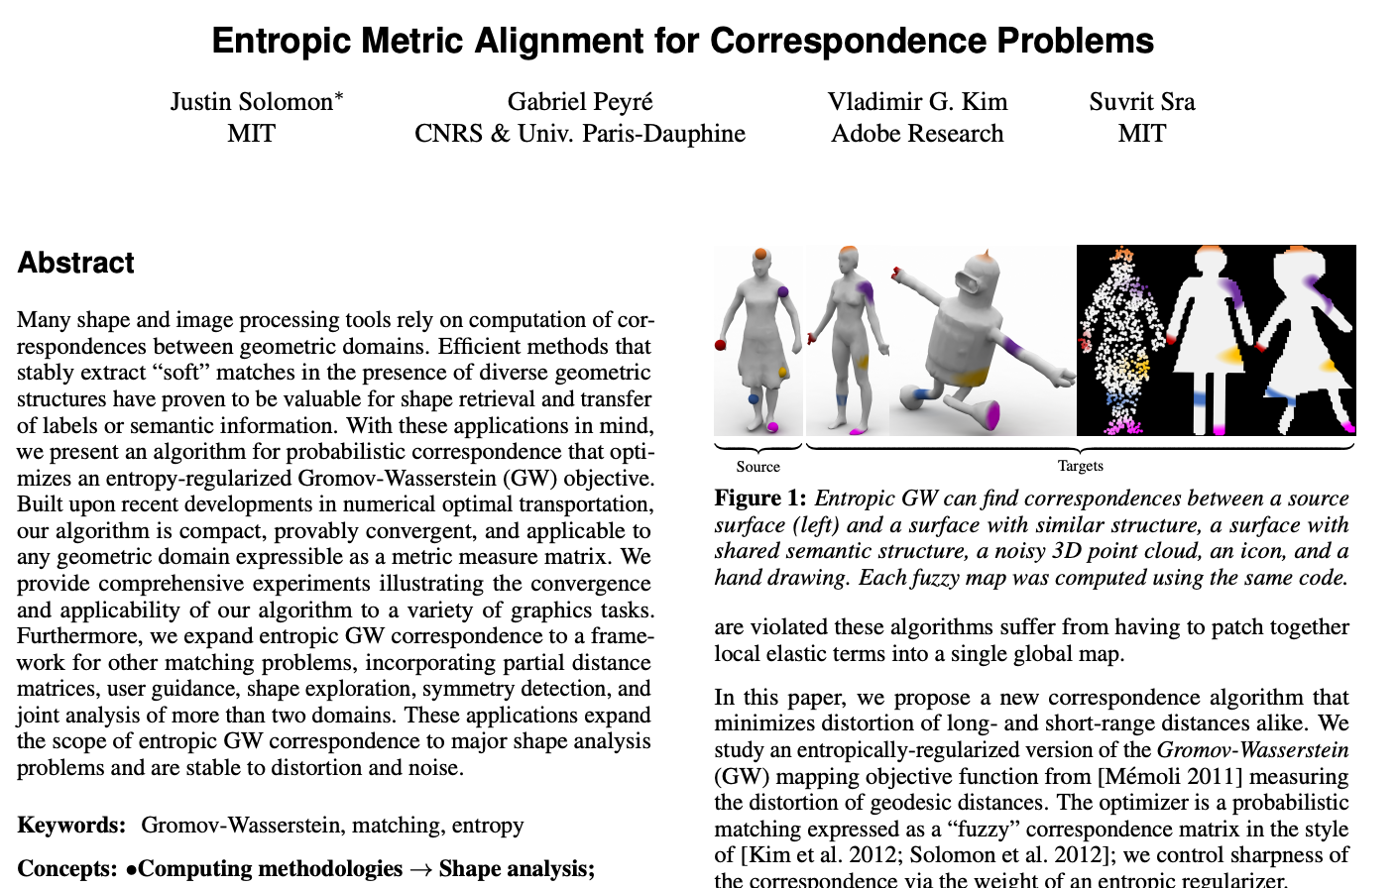
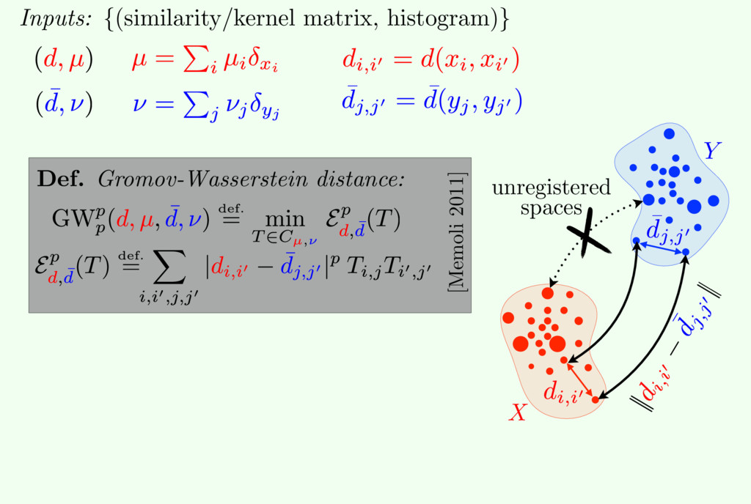
Gromov-Wasserstein
Traditionally solved in entropic/discrete settings
(Source: Gabriel Peyré, Justin Solomon, Marco Cuturi)

Slide 19
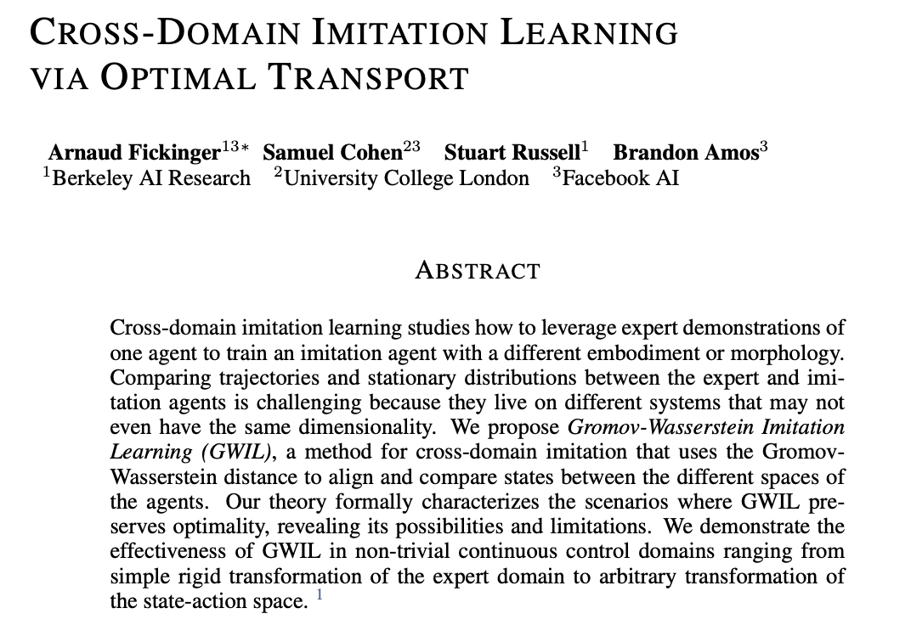
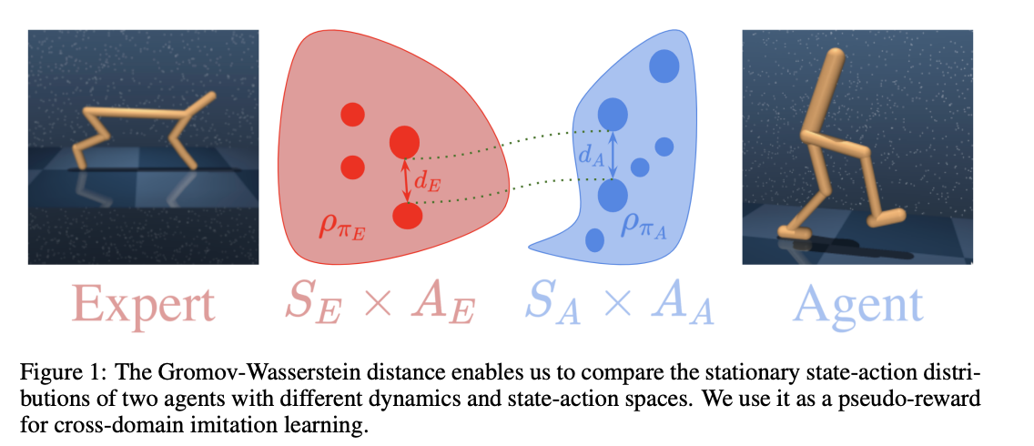
Gromov-Wasserstein for RL
Another application only using discrete GW, even though the spaces are truly continuous

Slide 20
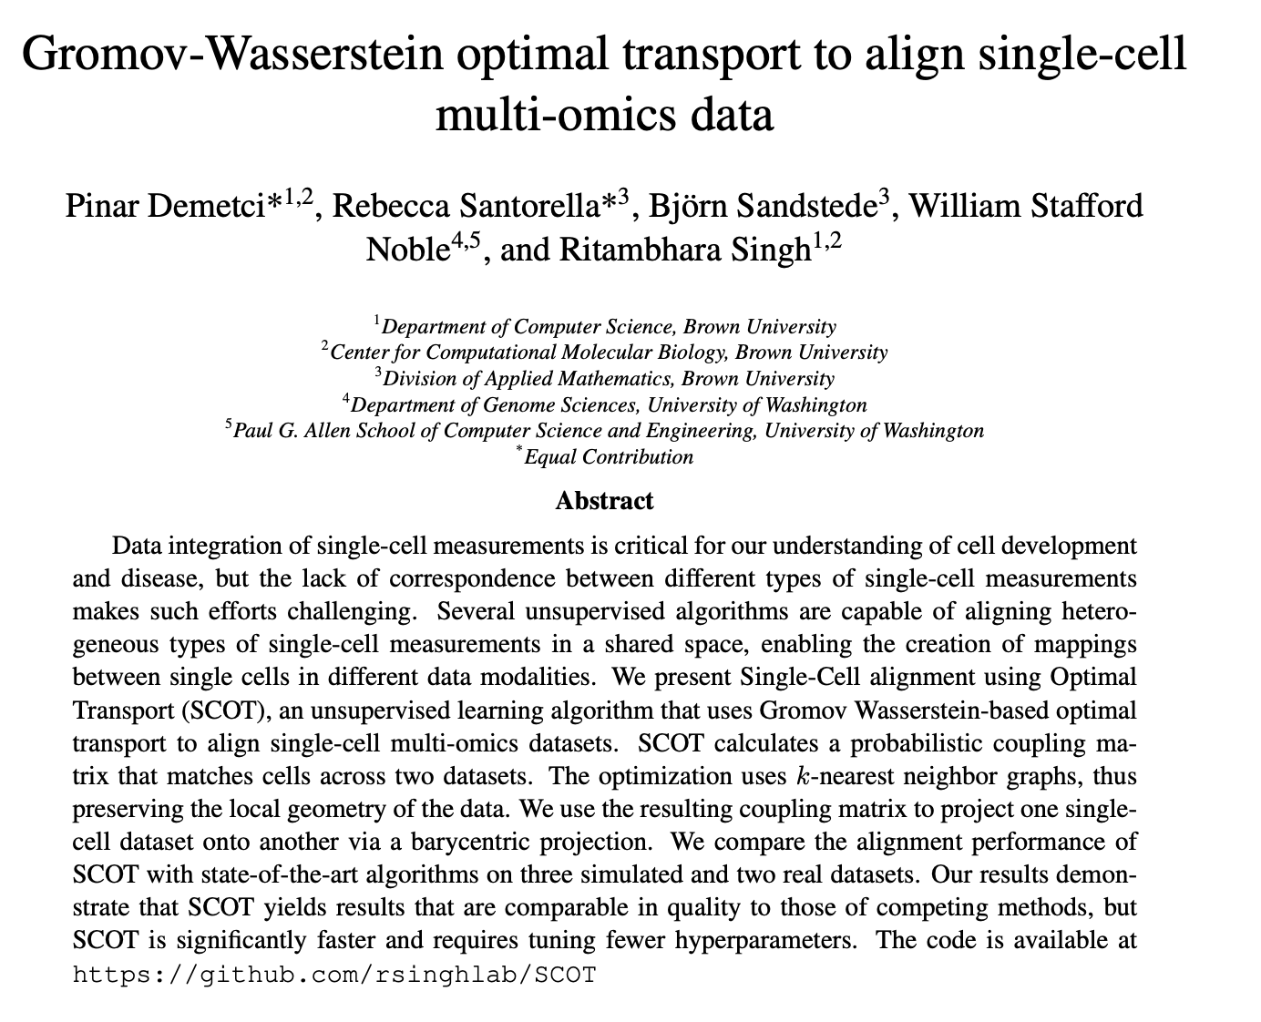
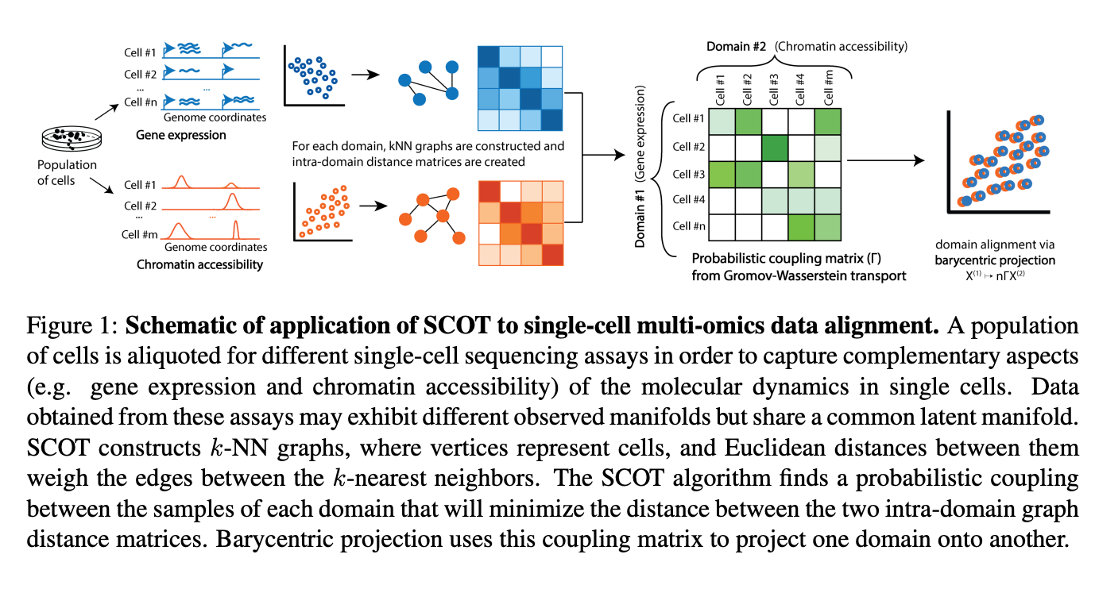
Gromov-Wasserstein for single-cell multi-omics
Another application only using discrete GW, could have continuous extensions

Slide 21
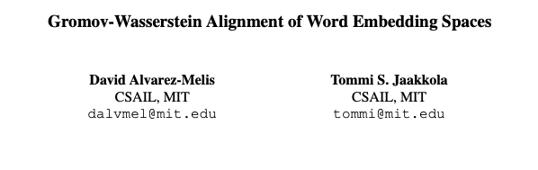
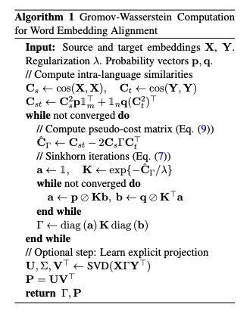
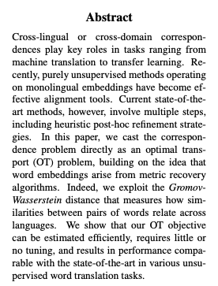
Discretizes a continuous feature space, solves discrete GW

Slide 22
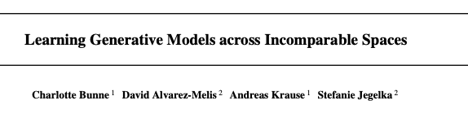
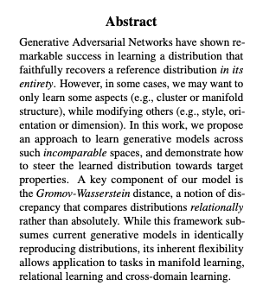
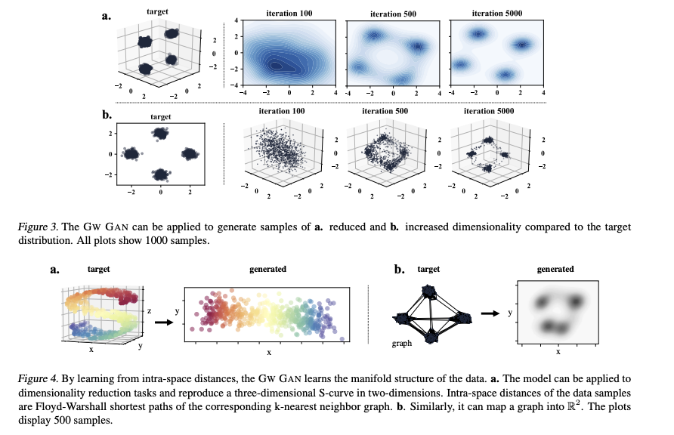
Discretizes continuous spaces, solves discrete GW

Slide 23
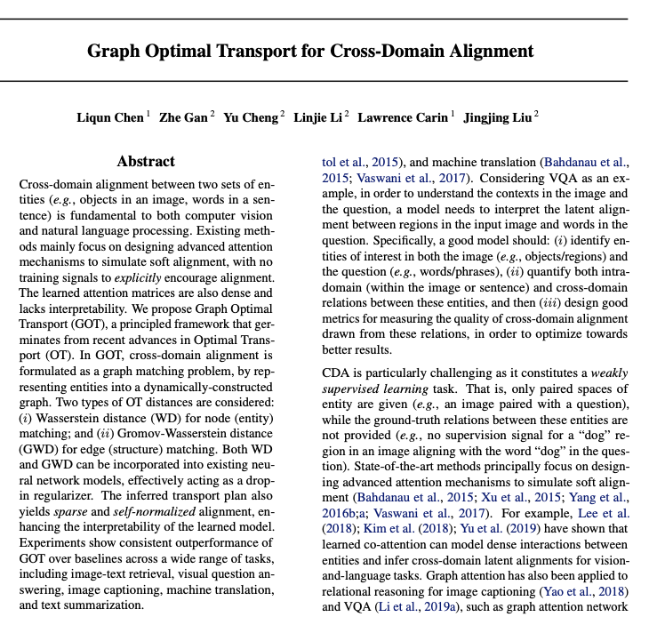
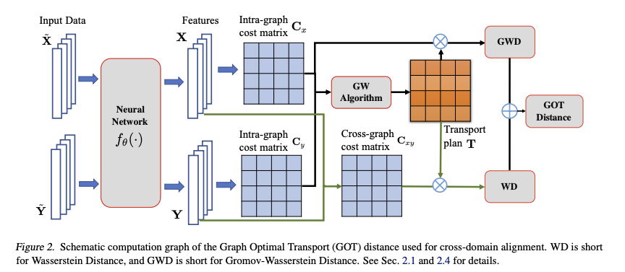
GW for cross-domain alignment
Discretizes a continuous feature space, solves discrete GW

Slide 24
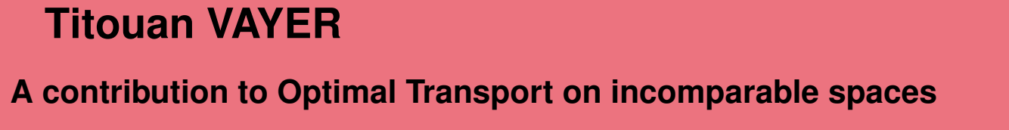
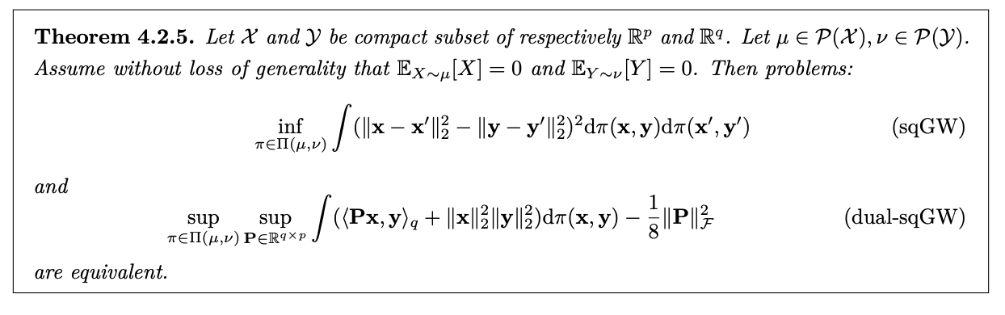
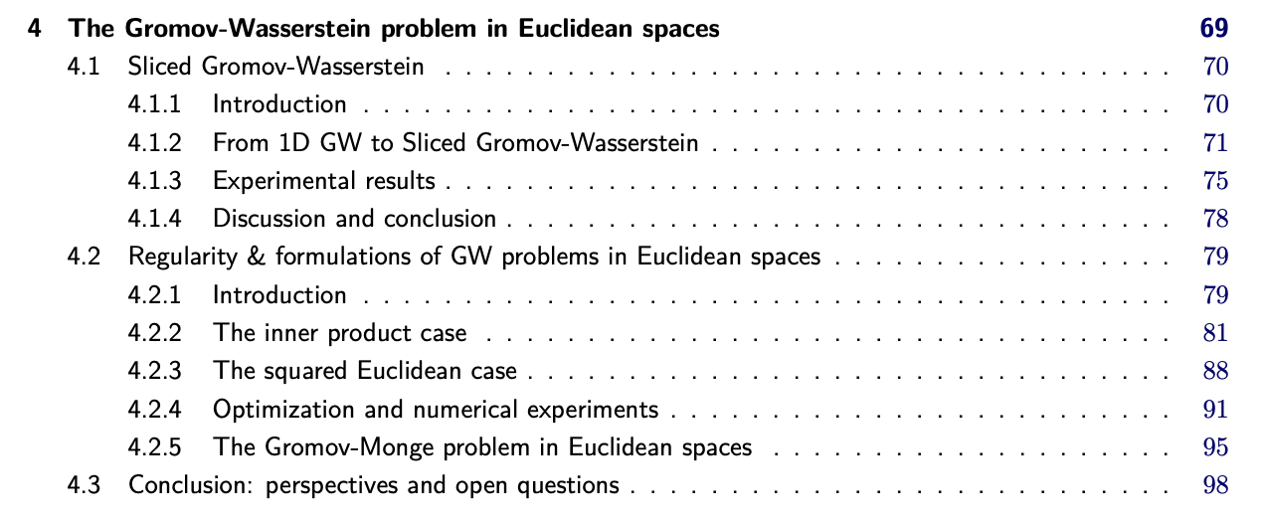
Continuous Gromov-Wasserstein
Studied theoretically, but not many computational instantiations
Seems promising to use other continuous OT methods (entropic or neural) for subproblems here

